Slide 1
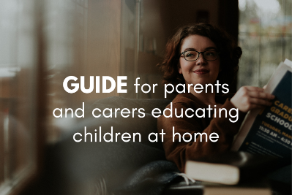
Before you start
Parents: read our helpful guidance before you start
Mental health and emotional wellbeing
KS1
Home learning lesson: We all have feelings
To start, play this slideshow from beginning

Slide 2
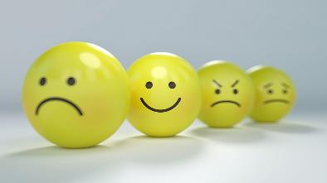
Y1-2 home learning:
We all have feelings

Slide 3
We are learning that we all have feelings
We will be able to:
recognise different feelings in ourselves and others
identify that people can feel differently about things and situations
explain who can help us with our feelings

Slide 4
We all have feelings:
What’s our starting point?
Meet Maz. Maz is an alien.
Maz is visiting earth to discover more about humans. Today Maz wants to learn all about feelings.
If you were telling Maz all about feelings, what would you say and talk about?

Slide 5
Naming and recognising feelings
Read the words from the Feelings vocabulary cards (Resource 1 in your pack). Choose some of words to think about.
Where in his body might Maz experience this feeling?
What might happen to his face when he feels it?
What might happen to his body when he feels it?
?
?
?
?
?
Look in a mirror and act out the feeling as if you are showing Maz.

Slide 6
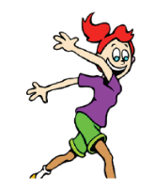
What are they feeling?
Help the characters identify their feelings. There are 5 stories to read.
Read Mia’s story.
What different feelings might she be experiencing?
Mia’s dad works in another country. Tonight she will get to video call her dad for the first time in ages.
Her tummy is tingling
She can’t keep still and jumps around a lot
Her voice is very loud
Feeling:………………………………………………..
excited

Slide 7
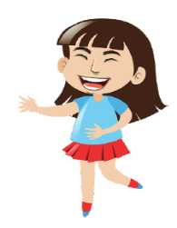
What are they feeling?
2. Read Jade’s story.
What different feelings might she be experiencing?
Jade’s favourite song is playing on the radio
She smiles
Her body is relaxed and calm
She laughs at her little brother’s dancing
Feeling:………………………………………………..
happy or joyful

Slide 8
What are they feeling?
3. Read Carlo’s story.
What different feelings might he be experiencing?
Carlos has got his best score ever on this week’s spelling test. He knows he’s getting better and is pleased that he practised.
He stands up tall
His body is calm
He smiles and laughs
Feeling:………………………………………………..
confident or proud

Slide 9
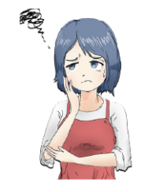
What are they feeling?
4. Read Mo’s story.
What different feelings might she be experiencing?
Mo sees an image on her screen that someone she doesn’t know sent her.
Her arms and legs are shaking
She finds it hard to breathe
Her body goes cold
Feeling:………………………………………………..
scared or worried

Slide 10
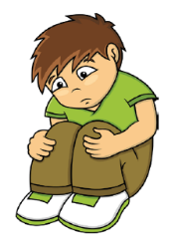
What are they feeling?
5. Read Amir’s story.
What different feelings might he be experiencing?
Amir has heard that his best friend might be moving to a new school.
His tummy aches
He keeps crying
He wants to be left alone
Feeling:………………………………………………..
sad or worried

Slide 11
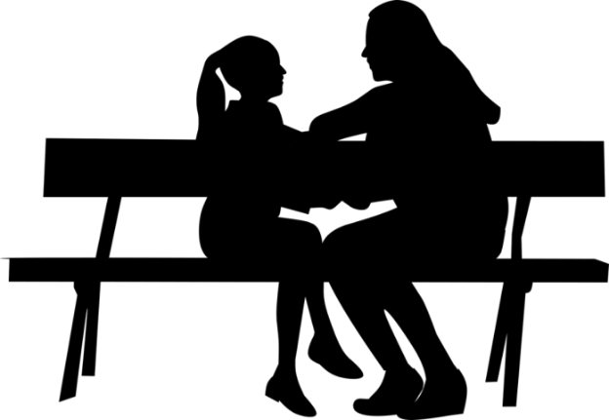
Sharing feelings
Sharing how we feel can help us with our feelings.
Who might need help with their feelings?
Mia might get over-excited and not be able to calm down. Her mum might need to help her.
Mia
Jade
Jade is really happy now, but most people are not happy all the time.
Carlos will probably want to share that he is feeling proud with someone else. He thinks his Granny will also be proud of him.
Carlos
It is really important that Mo tells an adult she trusts what has happened and how she feels so they can help.
Mo
It’s ok to be sad sometimes, but Amir should talk about the sad feelings with someone else to help him feel better.
Amir

Slide 12
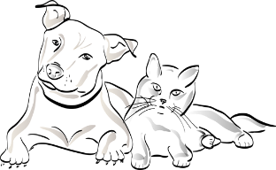
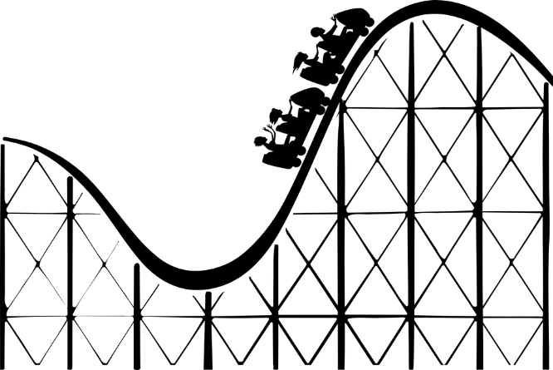
How things make us feel
We all feel differently about different things.
How might Maz feel about these things?
Is it a good or not so good feeling?

Slide 13
How Maz feels about…

Slide 14
Who or what could help Maz feel better?
Maz has never seen rain before! He is nervous to go outside in the rain for the first time.
Maz is afraid of dogs and cats. He thinks they all look very scary.
Maz is embarrassed to go to the party — he thinks his dancing is terrible!

Slide 15
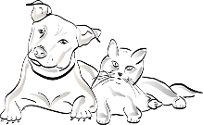
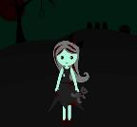
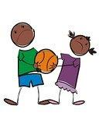
How do you feel about…
rain
fireworks
dogs and cats
the dark
roller-coasters
parties
falling out with a friend
spiders
Who or what could help you with your feelings?

Slide 16
We all have feelings
Well done on completing the activities!
Go back to the ‘What’s your starting point?’ activity
Do you remember that Maz wanted to find out about feelings?
Is there anything else that you would like to tell Maz?
Is there anything you would like to add?
Is there anything that you would like to change?

Slide 17
More activities
Interview a grown-up at home.
Choose three things from slide 15, ask if it makes them feel good, or not so good, and what positive things they might do to help them with their feelings.

